Slide 1

Faster R-CNN Coding Using Pytorch
Presenter: Kyeongseo Kim
Presentation date: February 22, 2024
Affiliation: School of Electronics and Electrical Engineering, Dankook University

Slide 2
Table of Contents
1. Before Faster R-CNN ..……………………………..…………….………..…..... 3
2. Faster R-CNN …...……………………………………………………………..…..... 9
3. Faster R-CNN Coding Using pytorch ..…….…………….………….. 14
4. Conclusions ………….………………………………………………….………….. 29

Slide 3
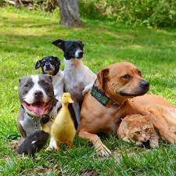



R-CNN (Regions with Convolutional Neural Networks)
1. Before Faster R-CNN
Purpose of R-CNN
Structure of R-CNN
Input Image
Extract region proposals (~2K)
Classification + Object Detection
Selective search
$$⋯$$
CNN
$$⋯$$
Warpping region
Dog, Duck
Classifiers(Support Vector Machine)
Bounding-box regression

Slide 4
R-CNN
1. Before Faster R-CNN
Limits of R-CNN
Image information is lost during the cropping/warpping process.
It takes a long time to apply CNN to all regions.
Multi-stage training requires a large storage space.
The speed of object detection is slow.

Slide 5


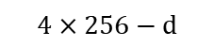
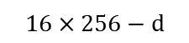

SPPNet (Spatial Pyramid Pooling Net)
1. Before Faster R-CNN
Structure of R-CNN with SPPNet
Input Image
Extract region proposal
Selective search
The number of inputs to CNN was reduced from 2000 to 1.
CNN
Spatial pyramid pooling layer
Spatial pyramid pooling layer
$$⋯$$
$$⋯$$
$$16×256−d$$
$$4×256−d$$
$$256−d$$
arbitrary size
Classifiers(SVM)
Spatial pyramid pooling make arbitrary size a fixed vector size.
Bounding-box regression

Slide 6
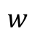
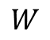
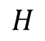
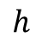
Fast R-CNN
1. Before Faster R-CNN
Structure of Fast R-CNN
Input Image
Extract region proposal
Selective search
RoI(Resion of Interest) Pooling layer
The same data that has passed through CNN can be used in Classifiers and Bounding-box regression.
CNN
Max pooling
RoI pooling layer
$$h$$
$$H$$
$$W$$
$$w$$
Classifiers(Softmax)
Bounding-box regression

Slide 7
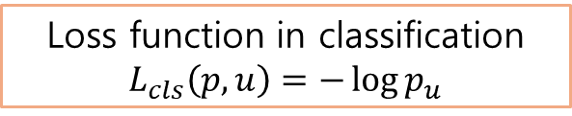
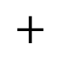
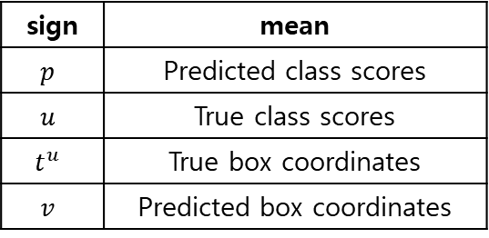
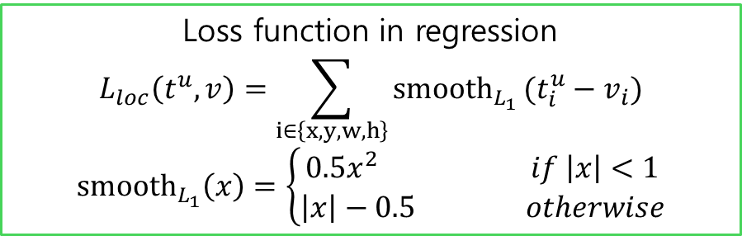
Fast R-CNN
1. Before Faster R-CNN
Loss Function of Fast R-CNN (Multi task loss)
$$L\left(p,u,t^{u},v\right)=L_{cls}\left(p,u\right)+λ\left[u≥1\right]L_{loc}(t^{u},v)$$
If it is background, it is 0.
Loss function in classification $L_{cls}\left(p,u\right)=−\log{p_{u}}$
sign | mean
$$p$$ | Predicted class scores
$$u$$ | True class scores
$$t^{u}$$ | True box coordinates
$$v$$ | Predicted box coordinates
$$+$$
Loss function in regression
$$L_{loc}\left(t^{u},v\right)=\sum_{i∈\left\{x,y,w,h\right\}}{{smooth}_{L_{1}}}(t_{i}^{u}−v_{i}) \\ {smooth}_{L_{1}}\left(x\right)=\left\{\begin{aligned}0.5x^{2} if \left|x\right|<1 \\ \left|x\right|−0.5 otherwise\end{aligned}\right.$$

Slide 8
Fast R-CNN
1. Before Faster R-CNN
Limits of Fast R-CNN
In Fast R-CNN, the Selective Search algorithm also operates outside the CNN, causing a bottleneck phenomenon.
Bottleneck Phenomenon
CPU
If one resource of the computer is slower than other resources, overall performance will decrease.
DATA
GPU
Bottleneck phenomenon

Slide 9
Faster R-CNN
2. Faster R-CNN
Structure of Faster R-CNN
Idea of Faster R-CNN
- Make region extraction be performed on the GPU to prevent bottleneck issues caused by performing it on the CPU.
- The convolution feature is shared between detection and region proposal network.
Input Image
CNN
Feature map
RPN
RoI Pooling layer
Region proposals
Fast R-CNN

Slide 10
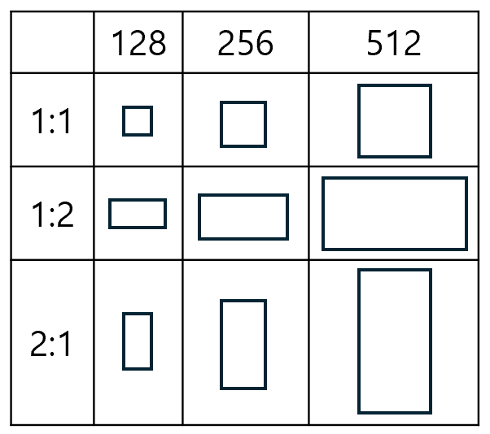
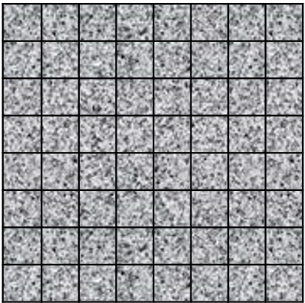
Faster R-CNN
2. Faster R-CNN
Not Using Anchors (Dense Sampling)
Anchors
Generate anchor boxes with various aspect ratios.
If sub-sampling ratio is 1/100,
800
8
800
8
Feature map
800
800
Image
Image
Number of generated bounding boxes: 64 (8x8)
Number of generated anchor: 64 (800/100 x 800/100)
Number of generated anchor boxes: 576 (9 x 64)

Slide 11
Faster R-CNN
2. Faster R-CNN
RPN(Region Proposal Networks)
- Convolution for class score
- Checks whether an object is included
- Set anchor box to 9 for every grid cell
2 x 9 channel
1 x 1 conv
Feature map
(h x w x 2 x 9)
Feature map
(h x w x 512)
3 x 3 conv
Feature map
(7 x 7 x 512)
Region proposals
1 x 1 conv
Feature map
(h x w x 4 x 9)
RoI Pooling layer
Fast R-CNN
- Convolution for bounding box regression
- Set anchor box to 9 for every grid cell
4 x 9 channel

Slide 12
Faster R-CNN
2. Faster R-CNN
Non-Maximum Suppression
Among the many proposals generated, only those that passed the NMS algorithm are left.
Sort boxes based on their scores.
Calculate the IoU of all other boxes.
If it is over 0.7, delete that box.
Before NMS
After NMS

Slide 13
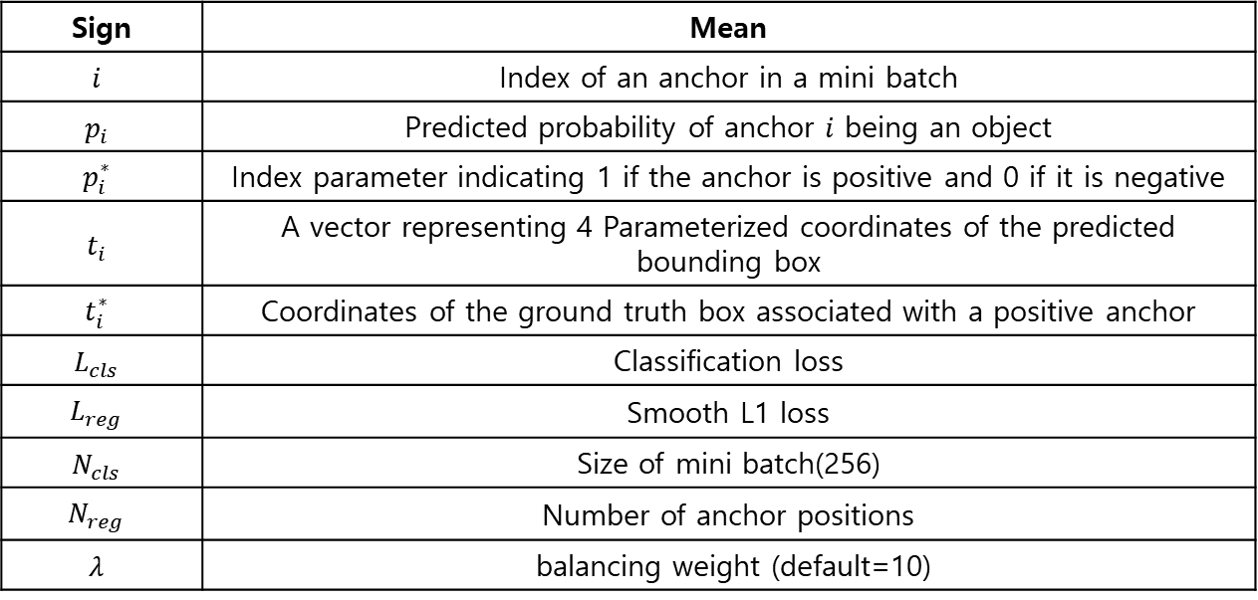
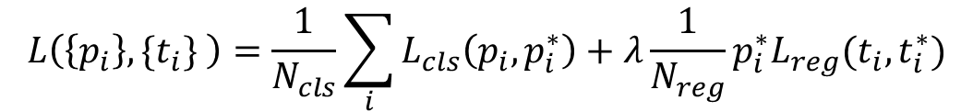
Faster R-CNN
2. Faster R-CNN
Loss Function
$$L\left(\left\{p_{i}\right\},\{t_{i}\} \right)=\frac{1}{N_{cls}}\sum_{i}{L_{cls}\left(p_{i},p_{i}^{∗}\right)}+λ\frac{1}{N_{reg}}{p_{i}^{∗}L}_{reg}(t_{i},t_{i}^{∗})$$
Sign | Mean
$$i$$ | Index of an anchor in a mini batch
$$p_{i}$$ | Predicted probability of anchor $i$ being an object
$$p_{i}^{∗}$$ | Index parameter indicating 1 if the anchor is positive and 0 if it is negative
$$t_{i}$$ | A vector representing 4 Parameterized coordinates of the predicted bounding box
$$t_{i}^{∗}$$ | Coordinates of the ground truth box associated with a positive anchor
$$L_{cls}$$ | Classification loss
$$L_{reg}$$ | Smooth L1 loss
$$N_{cls}$$ | Size of mini batch(256)
$$N_{reg}$$ | Number of anchor positions
$$λ$$ | balancing weight (default=10)

Slide 14
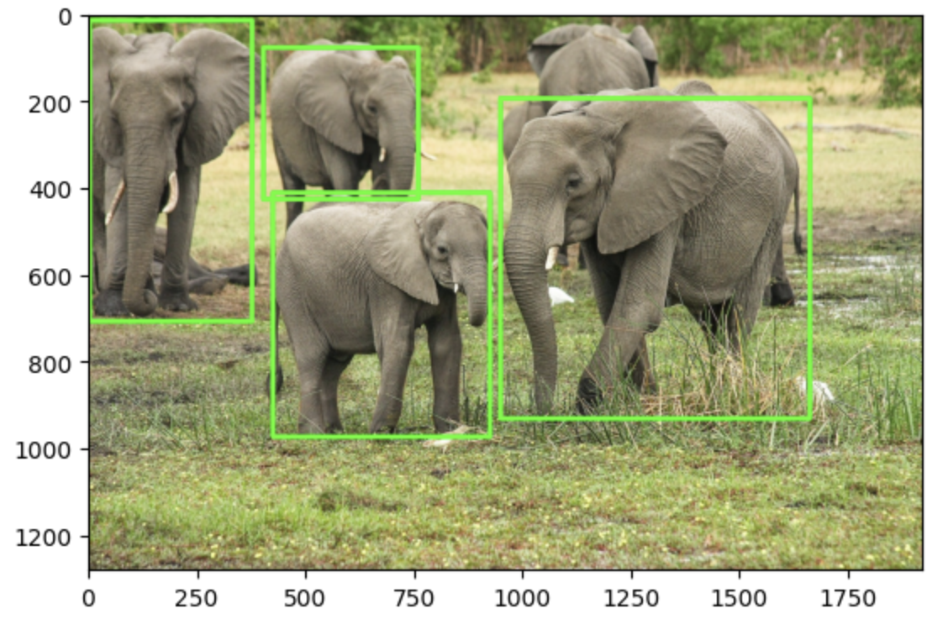
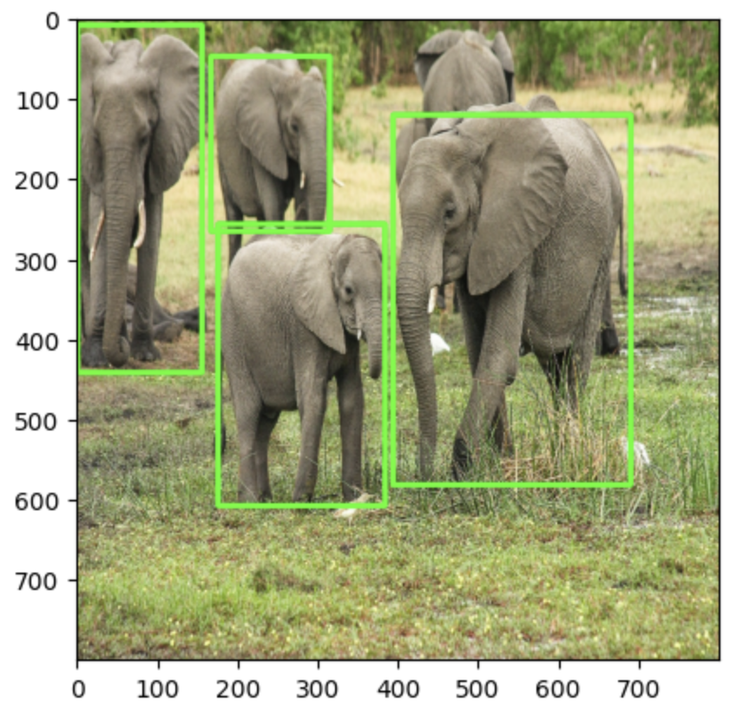
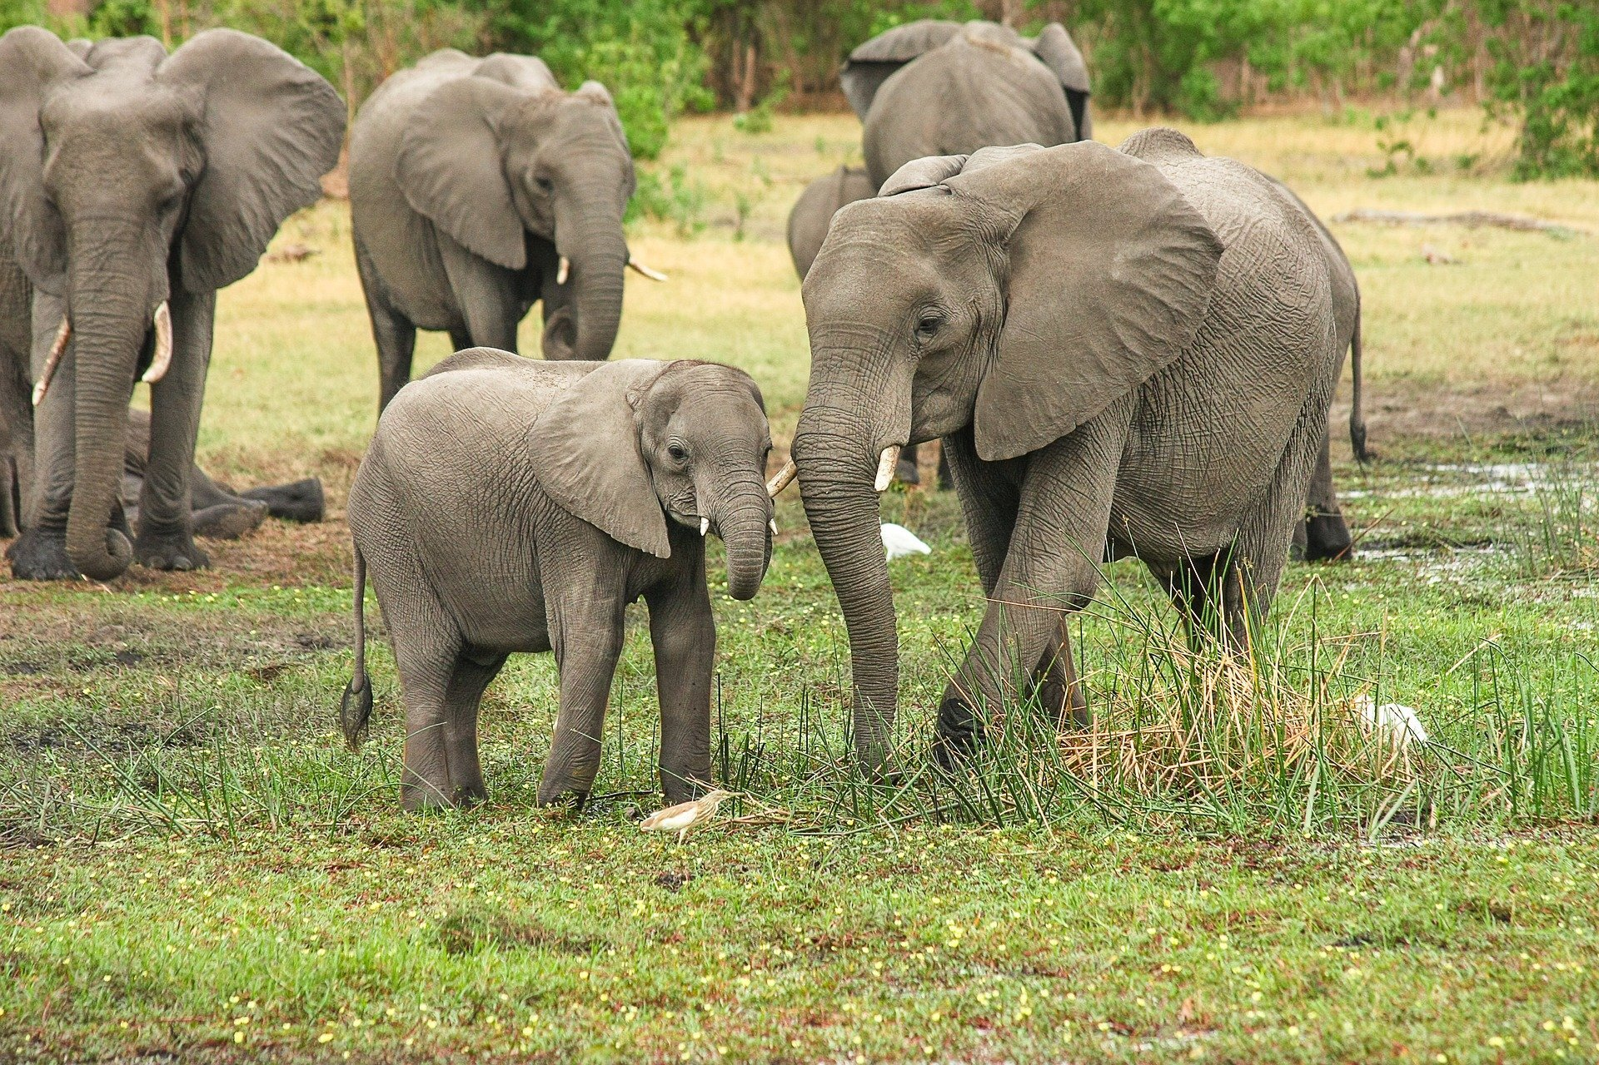
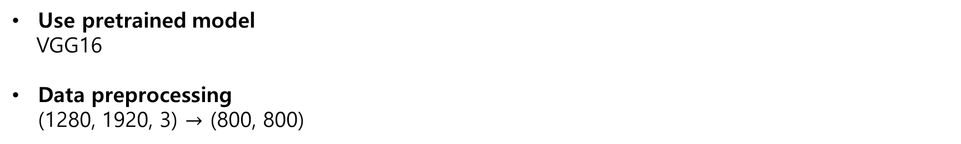
Lab Code
3. Faster R-CNN Coding Using pytorch
Use pretrained model
VGG16
Data preprocessing (1280, 1920, 3) $→$ (800, 800)
[424, 412, 923, 974],
[947, 195, 1658, 932],
[402, 78, 758, 427],
[3, 15, 376, 708]
[176 257 384 608],
[394 121 690 582],
[167 48 315 266],
[ 1 9 156 442]
Test image
Test image with bounding boxes
Resized test image with bounding boxes

Slide 15
Lab Code
3. Faster R-CNN Coding Using pytorch
Generate Anchor Boxes
feature_size = 800 // 16
ctr_x = np.arange(16, (feature_size + 1) * 16, 16)
ctr_y = np.arange(16, (feature_size + 1) * 16, 16)
index = 0
ctr = np.zeros((2500, 2))
for i in range(len(ctr_x)):
for j in range(len(ctr_y)):
ctr[index, 1] = ctr_x[i] - 8
ctr[index, 0] = ctr_y[j] - 8
index += 1
img_clone2 = np.copy(img)
ctr_int = ctr.astype("int32")
plt.figure(figsize=(7, 7))
for i in range(ctr.shape[0]):
cv2.circle(img_clone2, (ctr_int[i][0], ctr_int[i][1]),
radius=1, color=(255, 0, 0), thickness=3)
sub-sampling rate = 1/16
Anchor = 800/16 = 50
total anchor boxes = 50 x 50 x 9 = 22500

Slide 16
Lab Code
3. Faster R-CNN Coding Using pytorch
For a given anchor, create 9 anchor boxes for each combination of ratios and scales.
ratios = [0.5, 1, 2]
scales = [8, 16, 32]
sub_sample = 16
anchor_boxes = np.zeros(((feature_size * feature_size * 9), 4))
index = 0
for c in ctr:
ctr_y, ctr_x = c
for i in range(len(ratios)):
for j in range(len(scales)):
h = sub_sample * scales[j] * np.sqrt(ratios[i])
w = sub_sample * scales[j] * np.sqrt(1./ ratios[i])
anchor_boxes[index, 1] = ctr_y - h / 2.
anchor_boxes[index, 0] = ctr_x - w / 2.
anchor_boxes[index, 3] = ctr_y + h / 2.
anchor_boxes[index, 2] = ctr_x + w / 2.
index += 1

Slide 17
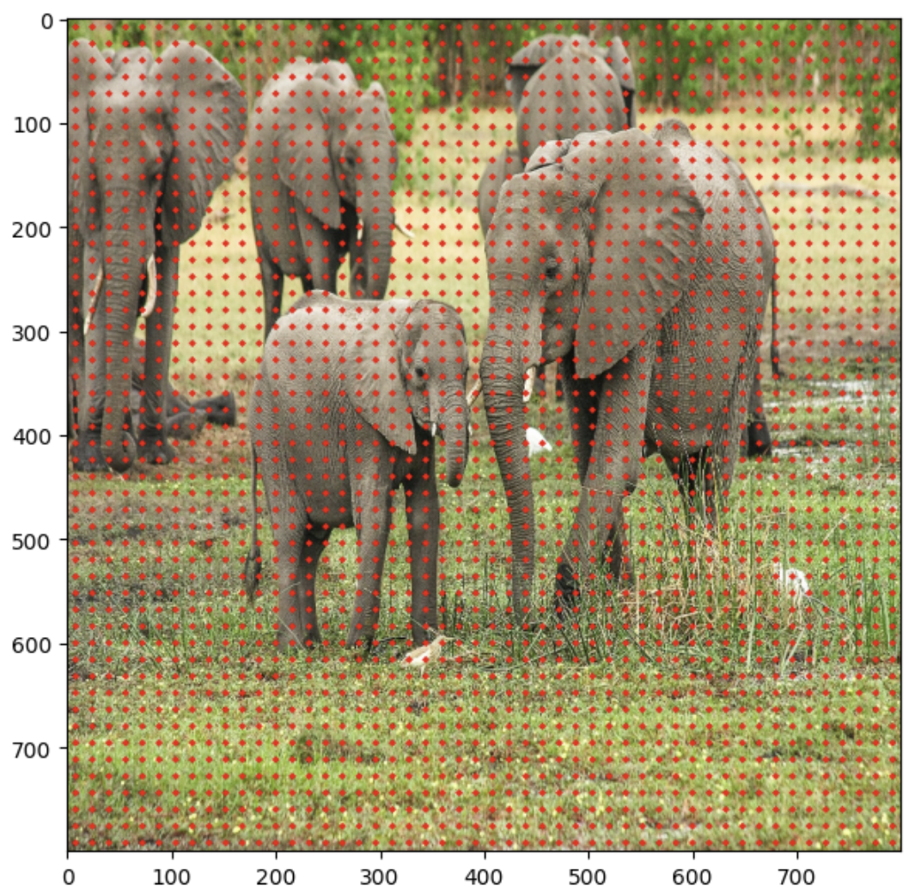
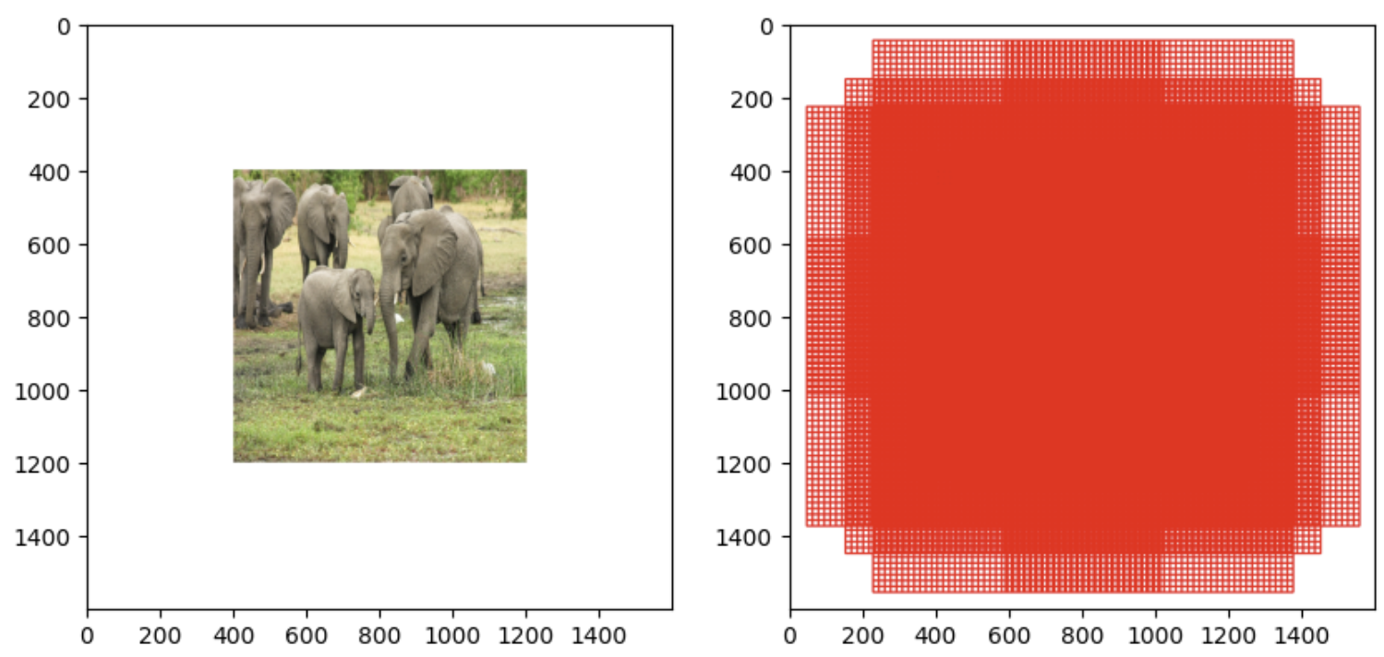
Lab Code
3. Faster R-CNN Coding Using pytorch
Generated anchors boxes
# valid anchor boxes with (x1, y1) > 0 and (x2, y2) <= 800
print(index_inside.shape)
Generated anchors
(8940,)
Anchors were created at 16 intervals from (8,8) to (792,729).
Only 8940 anchor boxes are inside the boundary out of 22500

Slide 18
Lab Code
3. Faster R-CNN Coding Using pytorch
Calculate IoU between each anchor box and ground truth box
ious = np.empty((len(valid_anchor_boxes),4), dtype=np.float32)
ious.fill(0)
for i, anchor_box in enumerate(valid_anchor_boxes):
xa1, ya1, xa2, ya2 = anchor_box
anchor_area = (xa2 - xa1) * (ya2 - ya1)
for j, gt_box in enumerate(bbox):
xb1, yb1, xb2, yb2 = gt_box
box_area = (xb2 - xb1) * (yb2 - yb1)
inter_x1 = max([xb1, xa1])
inter_y1 = max([yb1, ya1])
inter_x2 = min([xb2, xa2])
inter_y2 = min([yb2, ya2])
if (inter_x1 < inter_x2) and (inter_y1 < inter_y2):
inter_area = (inter_x2 - inter_x1) * (inter_y2 - inter_y1)
iou = inter_area / (anchor_area + box_area - inter_area)
else:
iou = 0
ious[i, j] = iou
[[0. 0. 0. 0.37780452]
[0. 0. 0. 0.33321926]
[0. 0. 0. 0.29009855]
[0. 0. 0. 0.24967977]
[0. 0. 0. 0.2117167 ]
[0. 0. 0. 0.17599213]
[0. 0. 0. 0.14231375]
[0. 0. 0. 0.11051063]
[0. 0. 0. 0.08043041]
[0. 0. 0. 0.05193678]]
Some IoU between $i_{th}$ anchor box and $j_{th}$ ground truth box

Slide 19
Lab Code
3. Faster R-CNN Coding Using pytorch
Print max IoUs in ground truth box.
gt_argmax_ious = ious.argmax(axis=0)
print(gt_argmax_ious)
gt_max_ious = ious[gt_argmax_ious, np.arange(ious.shape[1])]
print(gt_max_ious)
gt_argmax_ious = np.where(ious == gt_max_ious)[0]
print(gt_argmax_ious)
gt_argmax_ious
The index of the anchor box with the highest IoU.
gt_max_ious
IoU value with the maximum value for each ground truth box.
gt_argmax_ious
Index of the anchor box with the highest IoU value
Label according to IoUs.
[1008 2862 5935 8699]
[0.58514285 0.5752716 0.5255493 0.6325869 ]
[1008 1013 1018 1226 1232 1238 2862 2869 2876 3108 3115 3122 3336 3343 3350 3354 3357 3361 3364 3368 3371 3377 3383 3389 3600 3607 3614 3846 3853 3860 5935 5942 6164 6171 6178 6181 6185 6188 6192 6198 6427 6434 8699 8703 8707]
Results of print()
pos_iou_threshold = 0.7
neg_iou_threshold = 0.3
label[gt_argmax_ious] = 1
label[max_ious >= pos_iou_threshold] = 1
label[max_ious < neg_iou_threshold] = 0

Slide 20
Lab Code
3. Faster R-CNN Coding Using pytorch
Define RPN
in_channels = 512
mid_channels = 512
n_anchor = 9
conv1 = nn.Conv2d(in_channels, mid_channels, 3, 1, 1).to(DEVICE)
conv1.weight.data.normal_(0, 0.01)
conv1.bias.data.zero_()
reg_layer = nn.Conv2d(mid_channels, n_anchor * 4, 1, 1, 0).to(DEVICE)
reg_layer.weight.data.normal_(0, 0.01)
reg_layer.bias.data.zero_()
cls_layer = nn.Conv2d(mid_channels, n_anchor * 2, 1, 1, 0).to(DEVICE)
cls_layer.weight.data.normal_(0, 0.01)
cls_layer.bias.data.zero_()
reg_layer
conv1
1 x 1 conv
3 x 3 conv
cls_layer
1 x 1 conv

Slide 21
Lab Code
3. Faster R-CNN Coding Using pytorch
Classification and Bounding box regression
x = conv1(output_map.to(DEVICE))
pred_anchor_locs = reg_layer(x)
pred_cls_scores = cls_layer(x)
pred_anchor_locs = pred_anchor_locs.permute(0, 2, 3, 1).contiguous().view(1, -1, 4) pred_cls_scores = pred_cls_scores.permute(0, 2, 3, 1).contiguous() objectness_score = pred_cls_scores.view(1, 50, 50, 9, 2)[:, :, :, :, 1].contiguous().view(1, -1) pred_cls_scores = pred_cls_scores.view(1, -1, 2)
 | Mean | Size | print
pred_anchor_locs | Location of anchor box | torch.Size([1, 22500, 4]) | tensor([[[ 0.1149, -0.0829, -0.0057, -0.0004], [-0.0060, -0.0217, -0.0080, 0.0731], [-0.0690, -0.0075, -0.0096, 0.0374], ..., [-0.0241, 0.0261, 0.0073, 0.0522], [-0.0179, 0.0687, 0.0285, -0.0288], [ 0.0292, -0.0270, -0.0315, -0.0325]]])
pred_cls_scores | Probability for objects and background | torch.Size([1, 22500, 2]) | tensor([[[ 0.0413, 0.0409], [-0.0348, 0.0602], [-0.0052, -0.0354], ..., [-0.0086, 0.0109], [ 0.0310, 0.0335], [ 0.0410, 0.0147]]]
objectness_score | Probability of existence of object | torch.Size([1, 22500]) | [[0. 0. 0. 0.] [0. 0. 0. 0.] [0. 0. 0. 0.] ... [0. 0. 0. 0.] [0. 0. 0. 0.] [0. 0. 0. 0.]]

Slide 22
Lab Code
3. Faster R-CNN Coding Using pytorch
Multi task loss for RPN
rpn_cls_loss = F.cross_entropy(rpn_score, gt_rpn_score.long().to(DEVICE), ignore_index = -1)
print(rpn_cls_loss)
pos = gt_rpn_score > 0
mask = pos.unsqueeze(1).expand_as(rpn_loc)
print(mask.shape)
mask_loc_preds = rpn_loc[mask].view(-1, 4)
mask_loc_targets = gt_rpn_loc[mask].view(-1, 4)
print(mask_loc_preds.shape, mask_loc_targets.shape)
x = torch.abs(mask_loc_targets.cpu()-mask_loc_preds.cpu())
rpn_loc_loss = ((x < 1).float() * 0.5 * x ** 2) + ((x >= 1).float() * (x - 0.5))
print(rpn_loc_loss.sum())
rpn_lambda = 10
N_reg = (gt_rpn_score > 0).float().sum()
rpn_loc_loss = rpn_loc_loss.sum() / N_reg
rpn_loss = rpn_cls_loss + (rpn_lambda * rpn_loc_loss)
print(rpn_loss)
rpn_cls_loss
Loss of object existence classification using cross entropy function
rpn_loc_loss
Loss of bounding box regressor for positive samples using smooth L1
rpn_loss Final loss function combining both losses for rpn_lambda = 10
tensor(0.7047)
torch.Size([22500, 4])
torch.Size([45, 4]) torch.Size([45, 4]) tensor(15.1422)
tensor(4.0696)

Slide 23
Lab Code
3. Faster R-CNN Coding Using pytorch
Non maximum suppression(select 2000 bounding boxes)
Repeat NMS to remove overlapping boxes and store the finally maintained boxes in roi.
x1 = roi[:, 0]
y1 = roi[:, 1]
x2 = roi[:, 2]
y2 = roi[:, 3]
areas = (x2 - x1 + 1) * (y2 - y1 + 1)
order = order.argsort()[::-1]
keep = []
while (order.size > 0):
i = order[0]
keep.append(i)
xx1 = np.maximum(x1[i], x1[order[1:]])
yy1 = np.maximum(y1[i], y1[order[1:]])
xx2 = np.minimum(x2[i], x2[order[1:]])
yy2 = np.minimum(y2[i], y2[order[1:]])
w = np.maximum(0.0, xx2 - xx1 + 1)
h = np.maximum(0.0, yy2 - yy1 + 1)
inter = w * h
ovr = inter / (areas[i] + areas[order[1:]] - inter)
inds = np.where(ovr <= nms_thresh)[0]
order = order[inds + 1]
keep = keep[:n_train_post_nms]
roi = roi[keep]

Slide 24
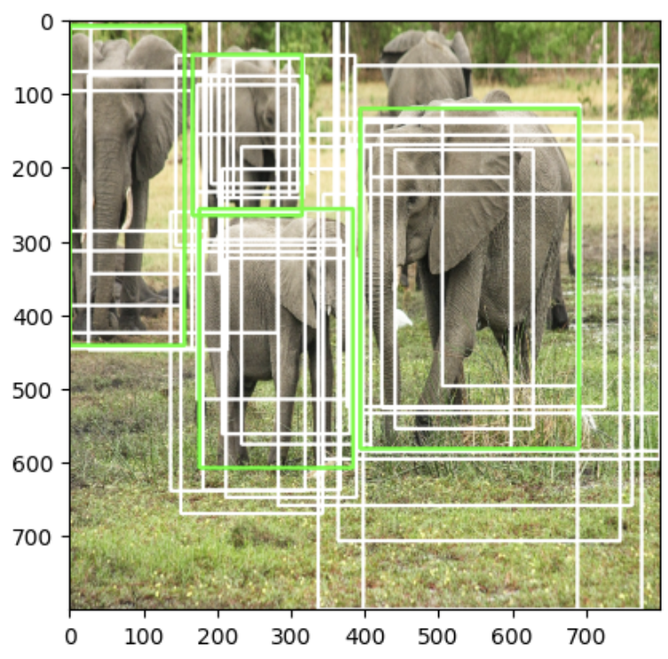
Lab Code
3. Faster R-CNN Coding Using pytorch
Select foreground(positive) samples with calculating IoUs
for num1, i in enumerate(roi):
ya1, xa1, ya2, xa2 = i
anchor_area = (ya2 - ya1) * (xa2 - xa1)
for num2, j in enumerate(bbox):
yb1, xb1, yb2, xb2 = j
box_area = (yb2 - yb1) * (xb2 - xb1)
inter_x1 = max([xb1, xa1])
inter_y1 = max([yb1, ya1])
inter_x2 = min([xb2, xa2])
inter_y2 = min([yb2, ya2])
if (inter_x1 < inter_x2) and (inter_y1 < inter_y2):
inter_area = (inter_y2 - inter_y1) * (inter_x2 - inter_x1)
iou = inter_area / (anchor_area + box_area - inter_area)
else:
iou = 0
ious[num1, num2] = iou
gt_assignment = ious.argmax(axis=1)
max_iou = ious.max(axis=1)
gt_roi_label = labels[gt_assignment]
pos_roi_per_image = 32
pos_index = np.where(max_iou >= pos_iou_thresh)[0]
pos_roi_per_this_image = int(min(pos_roi_per_image, pos_index.size))
You can see that a bounding box has generated around the elephant.

Slide 25
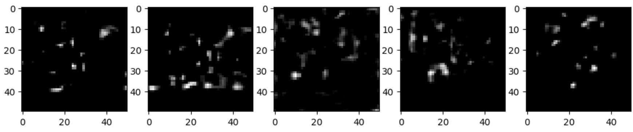
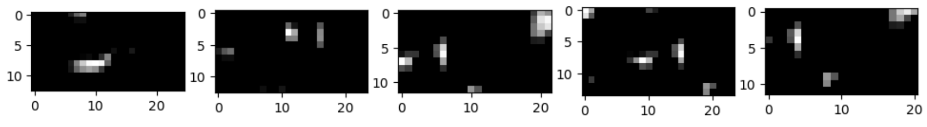
Lab Code
3. Faster R-CNN Coding Using pytorch
RoI Pooling
For each RoI, 7x7 max pooling is performed.
for i in range(num_rois):
roi = rois[i]
im_idx = roi[0]
im = output_map.narrow(0, im_idx, 1)[..., roi[1]:(roi[3]+1), roi[2]:(roi[4]+1)]
tmp = adaptive_max_pool(im)
output.append(tmp[0])
output = torch.cat(output, 0)
rois = torch.from_numpy(sample_roi).float()
roi_indices = 0 * np.ones((len(rois),), dtype=np.int32)
roi_indices = torch.from_numpy(roi_indices).float()
indices_and_rois = torch.cat([roi_indices[:, None], rois], dim=1)
xy_indices_and_rois = indices_and_rois[:, [0, 2, 1, 4, 3]]
indices_and_rois = xy_indices_and_rois.contiguous()
size = (7, 7)
adaptive_max_pool = nn.AdaptiveMaxPool2d(size[0], size[1])
output = []
rois = indices_and_rois.data.float()
rois[:, 1:].mul_(1/16.0)
rois = rois.long()
num_rois = rois.size(0)
 | The first 5 feature map
Before RoI Pooling
After RoI Pooling
torch.Size([128, 512, 7, 7])
Size of output after roi pooling
Visualize the first 5 feature map before RoI and after RoI

Slide 26
Lab Code
3. Faster R-CNN Coding Using pytorch
Fast R-CNN
roi_head_classifier = nn.Sequential(*[nn.Linear(25088, 4096), nn.Linear(4096, 4096)]).to(DEVICE)
cls_loc = nn.Linear(4096, 2 * 4).to(DEVICE)
cls_loc.weight.data.normal_(0, 0.01)
cls_loc.bias.data.zero_()
score = nn.Linear(4096, 2).to(DEVICE)
k = roi_head_classifier(k.to(DEVICE))
roi_cls_loc = cls_loc(k)
roi_cls_score = score(k)
roi_head_classifier
A network that receives ROI features as input and has 25088 inputs and 4096 outputs
cls_loc
Linear layer to predict class and location

Slide 27
Lab Code
3. Faster R-CNN Coding Using pytorch
Calssification Loss
gt_roi_loc = torch.from_numpy(gt_roi_locs)
gt_roi_label = torch.from_numpy(np.float32(gt_roi_labels)).long()
print(gt_roi_loc.shape, gt_roi_label.shape)
roi_cls_loss = F.cross_entropy(roi_cls_score.cpu(), gt_roi_label.cpu(), ignore_index=-1)
Regression Loss
n_sample = roi_cls_loc.shape[0]
roi_loc = roi_cls_loc.view(n_sample, -1, 4)
roi_loc = roi_loc[torch.arange(0, n_sample).long(), gt_roi_label]
pos = gt_roi_label > 0
mask = pos.unsqueeze(1).expand_as(roi_loc)
mask_loc_preds = roi_loc[mask].view(-1, 4)
mask_loc_targets = gt_roi_loc[mask].view(-1, 4)
x = torch.abs(mask_loc_targets.cpu() - mask_loc_preds.cpu())
roi_loc_loss = ((x < 1).float() * 0.5 * x ** 2) + ((x >= 1).float() * (x - 0.5))

Slide 28
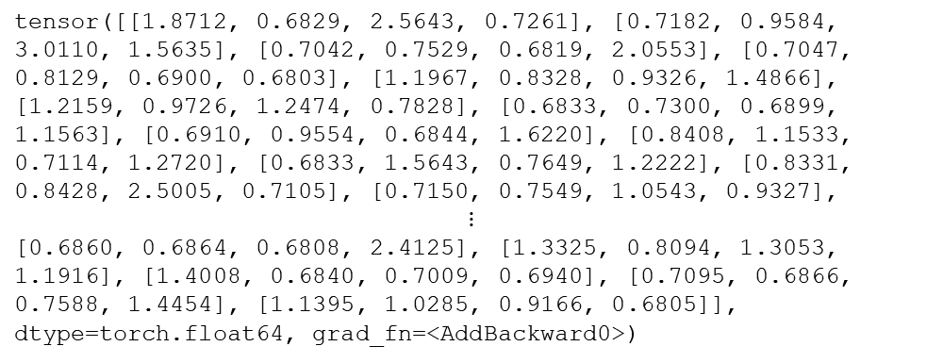
Lab Code
3. Faster R-CNN Coding Using pytorch
Multi Task Loss
roi_lambda = 10
roi_loss = roi_cls_loss + (roi_lambda * roi_loc_loss)
Result
roi_loss
rpn_loss
tensor([[1.8712, 0.6829, 2.5643, 0.7261], [0.7182, 0.9584, 3.0110, 1.5635], [0.7042, 0.7529, 0.6819, 2.0553], [0.7047, 0.8129, 0.6900, 0.6803], [1.1967, 0.8328, 0.9326, 1.4866], [1.2159, 0.9726, 1.2474, 0.7828], [0.6833, 0.7300, 0.6899, 1.1563], [0.6910, 0.9554, 0.6844, 1.6220], [0.8408, 1.1533, 0.7114, 1.2720], [0.6833, 1.5643, 0.7649, 1.2222], [0.8331, 0.8428, 2.5005, 0.7105], [0.7150, 0.7549, 1.0543, 0.9327],
$$⋮$$
[0.6860, 0.6864, 0.6808, 2.4125], [1.3325, 0.8094, 1.3053, 1.1916], [1.4008, 0.6840, 0.7009, 0.6940], [0.7095, 0.6866, 0.7588, 1.4454], [1.1395, 1.0285, 0.9166, 0.6805]], dtype=torch.float64, grad_fn=<AddBackward0>)
tensor(6.0471, device='cuda:0', dtype=torch.float64, grad_fn=<AddBackward0>)

Slide 29

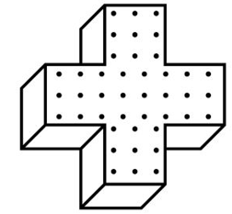

4 Conclusions
We learned the structure and limitations of R-CNN for object detection.
We learned the SPP layer and RoI layer to overcome the limitations of R-CNN.
To solve the bottleneck issue, we learned how to obtain region proposals through a convolution layer.
By implementing Faster R-CNN using pytorch, we learned the structure of RPN and confirmed that the correct bounding box was actually drawn.

